Slide 1


Multi
Media
Using Technology for Creations

Slide 2
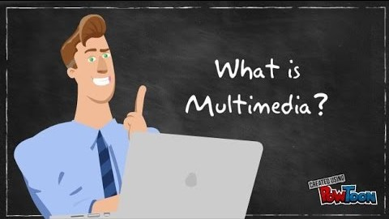
What is Multimedia??

Slide 3

Multimedia is the use of a computer to present and combine text, graphics, audio, and video with links and tools that let the user navigate, interact, create, and communicate. This definition contains four components essential to multimedia. First, there must be a computer to coordinate what you see and hear, and to interact with. Second, there must be links that connect the information. Third, there must be navigational tools that let you traverse the web of connected information. Finally, because multimedia is not a spectator sport, there must be ways for you to gather, process, and communicate your own information and ideas.

Slide 4
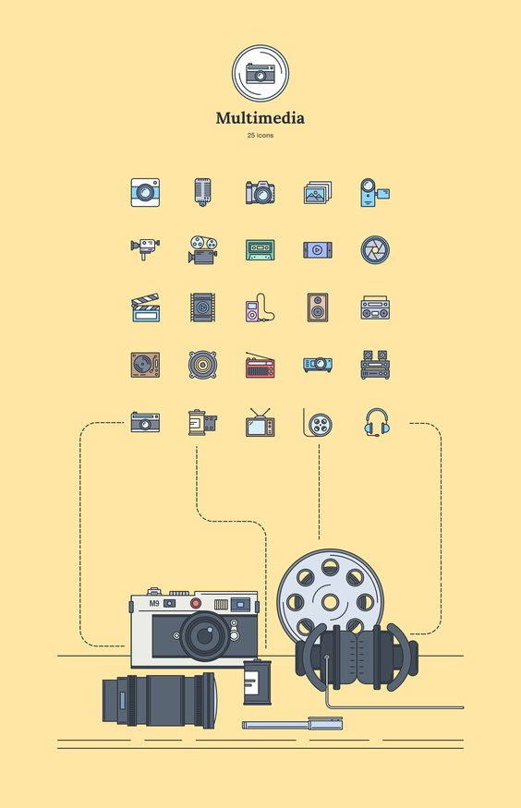
DIFFERENT TYPES OF MULTIMEDIA

Slide 5
01
Text
04
Graphics
02
Audio
05
Animations
03
Video
06
Graphic Objects

Slide 6
Multimedia
Skills

Slide 7

01
Project Manager
02
Multimedia Designer
03
Multimedia Programmer
01
04
Interface Designer
05
Writer
06
Video Specialist
07
Audio Specialist

Slide 8
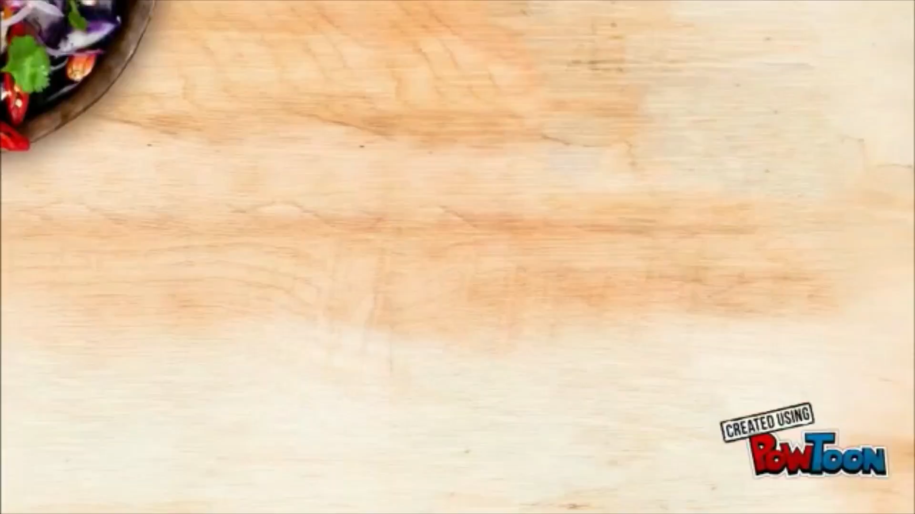
Why Do We Need Multimedia?

Slide 9
THANK YOU!
PRESENTED BY: AYUSHI SAINI
RA1711003010983

